Slide 1
NODE.JS
(The Backend Of MERN Stack)
Lecture 46

Slide 2
Today’s Agenda
What Is JWT Refresh Token ?
Creating A JWT Refresh Token
JWT Refresh Token Workflow
Exercise

Slide 3
What is A JWT Refresh token?
A JWT refresh token is used to generate a new access token.
Typically, if the access token has expired, the user would have to authenticate again to obtain an access token.

Slide 4
What is A JWT Refresh token?
With refresh token, this step can be skipped and with a request to the API get a new access token .
This allows the user to continue accessing the application resources.

Slide 5
The difference
It is the same as how we create access token by using payload (user's data), secret key and token expiry.
Here only difference is either there will be no expiry for refresh token or a very long expiry time like 3 years.
We can also store refresh token with user data in database for permanent persistence.

Slide 6
Creating a refresh token
Whenever the user gets authenticated with login credentials we will generate both the tokens: an access token and a refresh token.
The user can then continue to access the protected resources using access token .

Slide 7
Creating a refresh token
Now at some moment of time the access token will expire.
When this happens we will regenerate the access token with the help of refresh token.

Slide 8
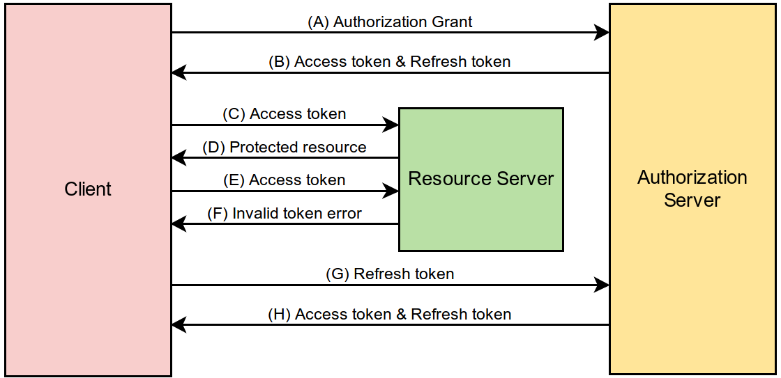
Jwt refresh token workflow

Slide 9
Exercise 96
Modify the register-login application by adding a new route api/auth/refresh which regenerates an access token using a refresh token

